Slide 1

BOSTON CRIME
Joslyn Fu,
Katherine Hu, Chenwei Wu,
Lu Yu

Slide 2




AGENDA
iNTRODUCTION
MODEL
INTERPRETATIONS
STRENGTH, LIMITATION AND FUTURE WORK
Background and Data

Slide 3

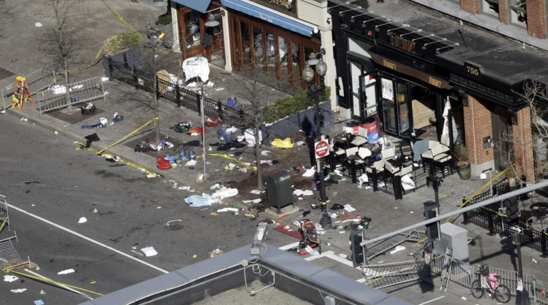
RESEARCH QUESTION AND MOTIVATION
For property-related, violent and other crimes, what are the main factors that induces these crimes to occur?
For severe crime — shooting, what are the main factors that induces its occurrence?
Man charged with murder in shooting death of UChicago graduate student
Complex crime scene in Boston history

Slide 4

INTRODUCTION
Our features are drawn from the below datasource:
Boston Crime Data
Neighborhood Data
Weather Data
Streetlight Data
MBTA Ridership and Stops Data
Police District & Zip Codes in Boston
Economics Data
Property Assessment Data
We grouped the crime data into three main categories: property-related crime, violent crime, and other crimes. For violent crime, we also categorized into shooting and non-shooting data.

Slide 5
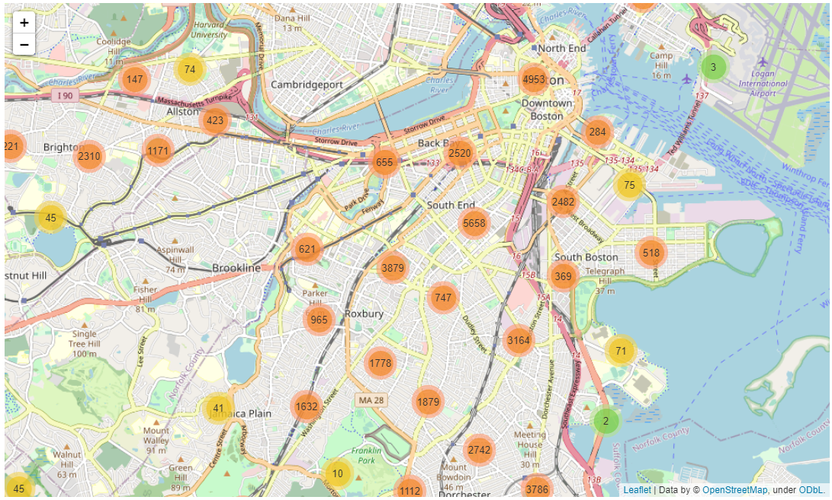
EDA
Geographical Distribution of Crimes Number across Boston
Notes:
Geographical location

Slide 6
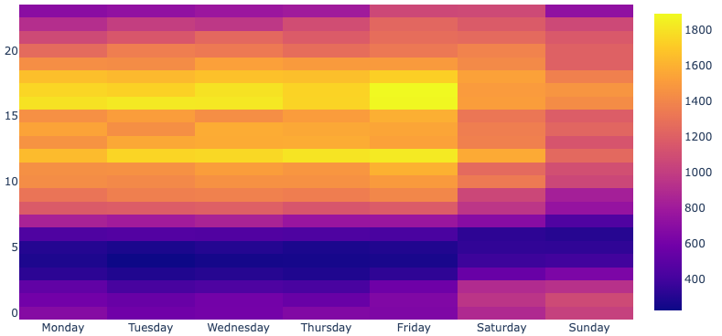
Number Of Crimes Each Hour

Slide 7
1: Question + Why are we doing this + Approach (what to predict and what features we have) - JF
2. What models we used + model selection process (5-fold cv) - lu
3. Feature importance -
4. Strength, limitations (12点的问题，数据本身的局限，）future work - JF

Slide 8

MODEL

Slide 9
GOALS
Shooting vs other violence crimes
Shooting is a type of Violence-related crimes
Violence-related vs all other crimes
All other crimes : property-related and other trivial crimes
Property-related vs all other crimes
All other crimes : violence-related and other trivial crimes
Other trivial vs all other crimes
All other crimes : violence-related and property-related crimes
Notes:
To answer our research question, we need to build 4 models to predict whether a crime incidence belongs to a certain crime type. The first one is to predict whether the crime is shooting or other violence crime. Second one is to predict whether it is a violence or other crime type, etc.

Slide 10
bASELINE MODEL
Predicting the Most Frequent Class
Target Value | True | False | Total | Percentage (%) | Accuracy Rate
Shooting | 759 | 5257 | 6016 | 12.6 | 87.4%
Violence | 6016 | 60806 | 66822 | 9 | 91%
Property | 21093 | 45729 | 66822 | 31.6 | 68.4%
Other Trivial | 39713 | 27109 | 66822 | 59.4 | 59.4%
Imbalance Classification:
Class Weighting Method
Metrics
Notes:
We have our baseline model as predicting the most frequent class for each target value. And we got extremely high accuracy rate for shooting and violence because of the imbalance class problem. To deal with the imbalance classification, we use the class weighting method by assigning weight to each class when computing loss. We also choose certain metrics other than accuracy rate to measure our model’s performance.

Slide 11
METRICS
ROC AUC SCORE
Tells how much the model is capable of distinguishing between class
F-1 SCORE
Combines the precision and recall of a classifier
Through hyperparameter tuning, we evaluate our models through 5 metrics.
Priority:
F-1 Score & ROC AUC >>
Recall Score & Confusion Matrix >>
Accuracy Score
RECALL SCORE
Ratio of correctly predicted positive observation/ all observations
CONFUSION MATRIX
To evaluate TF, TN, FP, FN
ACCURACY SCORE
Fraction of predictions our model got right
Notes:
We have in total 5 metrics but we emphasize a lot on F-1 score and roc-auc score which are suitable measures of models tested with imbalanced datasets. Then we look at recall score and confusion matrix if there’s any discrepancy between f-1 and roc-auc. The very last measure is the accuracy score.

Slide 12
MODEL
Logistic Regression
Random Forest
Training : Testing = 8:2
Model Selection Process:
5-fold GridSearch CV
AdaBoost
XGBoost
LightGBM
Notes:
We apply 5 modeling techniques to understand what factors contribute to different crime types. They are logistic regression with regularization, random forest, adaboost, xgboost and light GBM. We have 20% as our test set and apply 5-fold cross validation to select the best hyperparamters of each model using GridSearch.me

Slide 13
PERFORMANCE
Target Value | Best Model | ROC-AUC | F-1 | Recall | Accuracy Rate
Shooting | Random Forest | 80% | 28% | 63.9% | 80.3%
Violence | XGBoost | 59.8% | 19.3% | 52.5% | 60.7%
Property | XGBoost | 64.4% | 48.7% | 57.5% | 61.8%
Other Trivial | Random Forest | 65% | 74.9% | 89.8% | 64.2%
Notes:
Here is the result table of the best model to predict four crime types. Random forest do best in predicting shooting and other trivial crimes whereas XGBoost work the best at predicting violence-related and property-related crimes. Basically all models have lower accuracy rate than the baseline model but the roc-auc are higher than 50% which means our models can still learn something from the data about the different crime types. Especially for predicting shooting, our roc-auc is as high as 80%.

Slide 14

RESULT
AND
INTERPRETATION

Slide 15
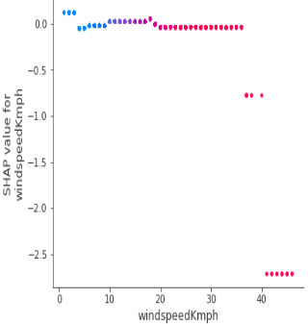
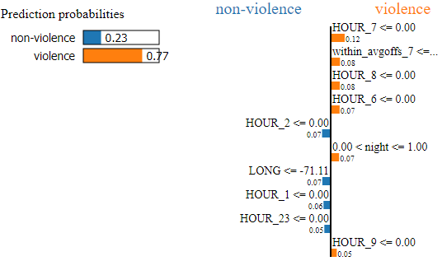
FEATURE IMPORTANCE
- METHODOLOGY
Windspeed V.S. SHAP values for Violent Crimes
Global Importance
Logistic Regression : Coefficients
Random Forests: Mean decrease in Gini
XGBoost: Gain, Weight, Cover
Local Importance
LIME (Local Interpretable Model-agnostic Explanations)
SHAP values: Summary Plot to get top features + Dependence Plots for each feature
LIME - Violent Crime Incidence Prediction
Notes:
To identify the top features contributing to each of the crime types and understand in which direction they are affecting our predictions, we look at both model wise global importances and instance wise local importances. Apart from common model specific methodologies like coefficients for logistic and mean gini for RF, We also look at shap values. On the top right here is a plot of windspeed vs shap values for violent crimes, we could tell that as wind speed increases the chances of having violent crimes sharply deceases.
For local importance , LIME perturbs the original data point for one data instance and observes the changes corresponding outputs. Bottom right We can see that this incident is classified as violent mostly because of its time.

Slide 16
FEATURE IMPORTANCE
- SUMMARY
Shared Features: Time (Night, Non-busy hours..), Distance from crowd (avg load on and load off, distance & number of streetlights…), Neighborhood Affluence (Years of houses built, Income…)
Shooting: Dependent on nearby traffic and street lights, education and household types
Violence: Highly time dependent, Weather (higher temperature, less extreme weather)
Property: Very dependent on time and distances from streetlights and traffic, local residential structures (living alone)
Other Trivial: Most dependent on nearby crowd
Notes:
albeit all having interesting distinctions, top contributing factors to different types of crimes in Boston overlap widely.

Slide 17

STRENGTHs, LIMITATIONs, AND FUTURE WORK

Slide 18


STRENGTHs
LIMITATIONs
We intentionally disregard race as an input variable to avoid racial discriminations.
We provide in-depth feature importance analysis to understand the factors behind all the different types of crime.
Selection Bias:
selection of variables
datasource
Modeling and metrics
limited number of models
limited hyperparameter tuning
limited selection of metrics
Notes:
Limitations: aware of the selection bias, which could occur during the selection of variables and data source, and the limitations of modeling and metrics, where we applied limited number of modeling, hyperparameter tuning, and selection of metrics

Slide 19
FUTURE WORK
INCLUSION OF MORE DATASET
COMPARISON OF DIFFERENT CITIES
CAUSAL & COUNTERFACTUAL ANALYSIS
PREDICTIVE ANALYSIS
Possible variables: religious characteristic
BOSTON vs. NEW YORK vs. SAN FRANCISCO
To strengthen causal argument
Identify future outcomes to reduce risks
Notes:
Future Work, we encourage scholars to look into inclusion of more dataset, variables and comparison of different cities.
We also find causal and counterfactual analysis would improve causal argument, and predictive analysis would help identify future outcomes to reduce future potential risk.

Slide 20

THANK YOU
Notes:
Thank you for listening!!!

